Slide 1
AZURE Repo Use SSH key authentication - Guide
Shlomi Alon
July 2022

Slide 2
Introduction
How SSH key authentication works
SSH public key authentication works with an asymmetric pair of generated encryption keys. The public key is shared with Azure DevOps and used to verify the initial ssh connection. The private key is kept safe and secure on your system.
Set up SSH key authentication
The following steps cover configuration of SSH key authentication on the following platforms: Linux, macOS running at least Leopard (10.5), Windows systems running Git for Windows
Configure SSH using the command line. bash is the common shell on Linux and macOS and the Git for Windows installation adds a shortcut to Git Bash in the Start menu. Other shell environments will work, but are not covered in this article.

Slide 3
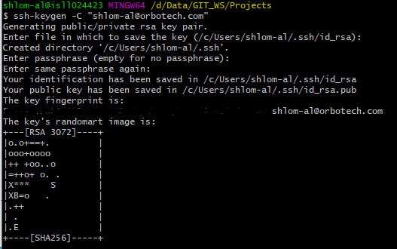
Step 1 Create your SSH keys
Create your SSH keys with the ssh-keygen command from the bash prompt. This command will create a 3072-bit RSA key for use with SSH. You can give a passphrase for your private key when prompted—this passphrase provides another layer of security for your private key. If you give a passphrase, be sure to configure the SSH agent to cache your passphrase so you don't have to enter it every time you connect.
This command produces the two keys needed for SSH authentication: your private key ( id_rsa ) and the public key ( id_rsa.pub ). It is important to never share the contents of your private key. If the private key is compromised, attackers can use it to trick servers into thinking the connection is coming from you.

Slide 4
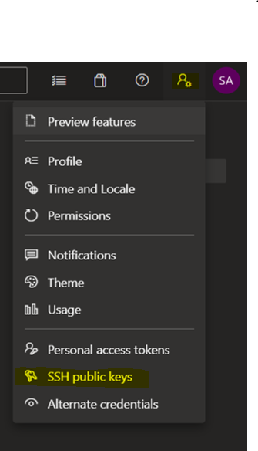
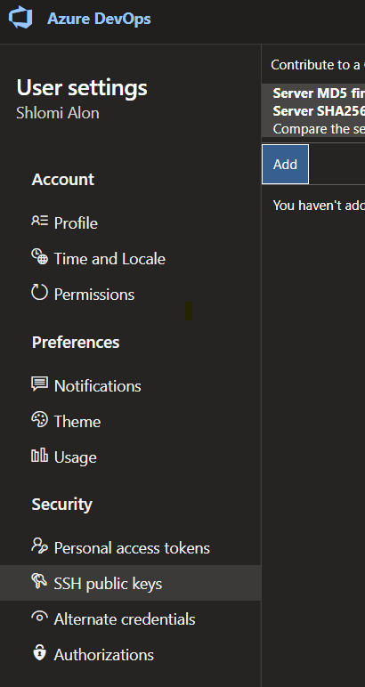
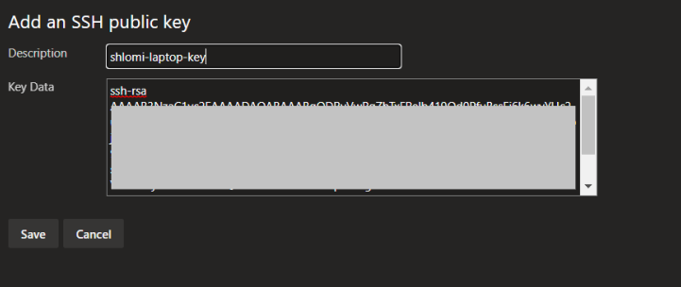
Step 2 – Add the public key to Azure
Open your security settings by browsing to the web portal and selecting your avatar in the upper right of the user interface. Select SSH public keys in the menu that appears.
Select Add.
Copy the contents of the public key (for example, id_rsa.pub) that you generated into the Public Key Data field.
Select Save to store the public key.

Slide 5
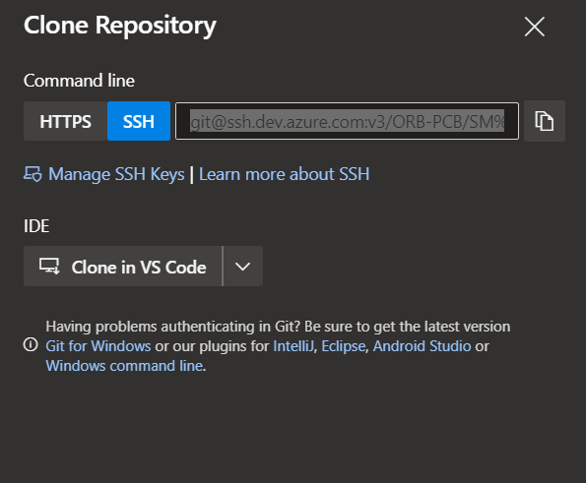
Step 3 Clone the Git repository with SSH
Copy the SSH clone URL from the web portal. In this example, the SSL clone URL is for a repo in an organization named ORB-PCB/SM DI, as indicated by the first part of the URL after dev.azure.com

Slide 6
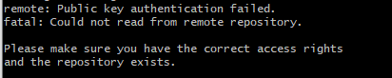
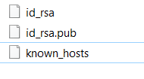
In case of problem
Go to ~/.ssh – remove
ssh-keyscan -t rsa ssh.dev.azure.com >> ~/.ssh/known_hosts
ssh-keygen -C shlom-al@orbotech.com
open the public key with this command - cat ~/.ssh/id_rsa.pub
Add the id_rsa.pub key to SSH keys list on your Azure profile.

Slide 7
Thank You.

